Slide 1

SUMMER TRAINING PROJECT
Web App :
CareerPathAdvisor.ai
Name : Shivam
Roll No. : 2337056
Semester : 5th
Course : B. Tech. CSE
Training Course : Generative AI
Batch : 1

Slide 2

Introduction to AI Career Path Advisor Web App
Innovative web app designed for career guidance
Utilizes Generative AI to provide personalized advice
Aims to assist users in exploring career paths effectively

Slide 3

Technology Behind the Web App
Generative AI : Built using Gemini 2.5 Flash Model
Programming Language : Developed with Python
Deployment : Deployed with Streamlit

Slide 4

Deployment Method
Deployed using Streamlit
Advantages:
Simplifies web app development
Enables rapid deployment and iteration
User-friendly interface for seamless interaction
Link to open the Web App : AI Career Path Advisor

Slide 5
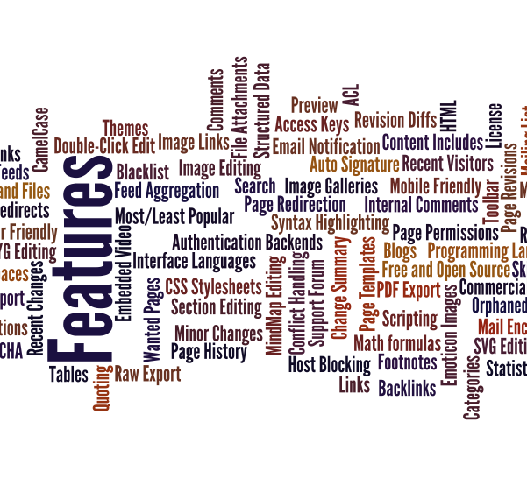
Key Features of the App
Personalized Career Advice : Tailored recommendations based on user input
User-Friendly Interface : Intuitive design for easy user interface
Anonymous : Login or signup is not required
Public Access : Anyone can access it publicly

Slide 6

Benefits of Using the App
Enhanced Career Guidance: Provides insights into various career options
Accessibility: Available to a wide audience, including students and professionals
Tailored Recommendations: Personalized suggestions for individual career paths

Slide 7

Future Scope
Potential developments and Improvements :
User Signup and Login
Storing History
Integration with educational resources for comprehensive guidance
Generating Images for creation of roadmaps
Image Uploading for Resume Analysis

Slide 8
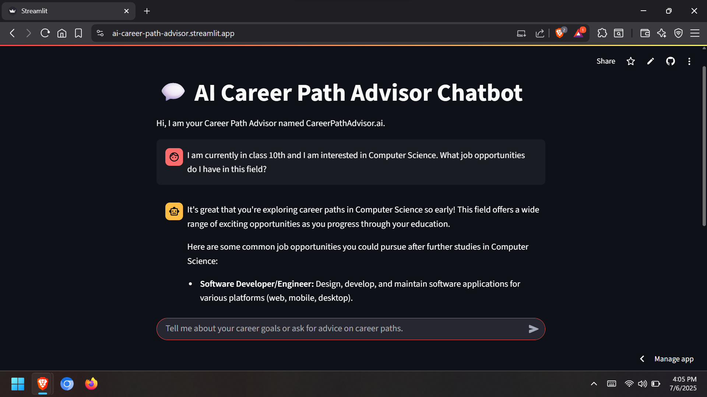
Visual Showcase

Slide 9

Thank You!
Any queries?
Feel free to ask!

